Slide 1
UNLOCKING FINANCIAL INSIGHTS: ATLIQ DATA SERVICES STRATEGIC PROPOSAL FOR MITRON BANK'S CREDIT CARD PROJECT

Slide 2
Exploring Mitron Bank:
Mitron Bank, a distinguished legacy institution headquartered in Hyderabad, is poised to revolutionize the financial landscape with the introduction of a groundbreaking line of credit cards.
This strategic initiative is designed to not only expand Mitron Bank's product portfolio but also to enhance its market presence, offering innovative solutions that cater to the evolving needs of its clientele.
With a commitment to excellence, Mitron Bank invites you to explore the possibilities and redefine your financial journey. Welcome to a new era of banking convenience and sophistication. Discover the future with Mitron Bank's latest credit card offerings

Slide 3
Mitron Bank's Data-Driven Journey with AtliQ Data Services
AtliQ Data Services initiates a transformative project with Mitron Bank, proposing enhancements to their services.
In response, Strategy Director Mr. Bashnir Rover mandates a pilot project, demanding a sample dataset analysis spanning 4000 customers across five cities before committing to full implementation.
Tasked with analyzing this data, the data analyst focuses on identifying trends, providing actionable recommendations for tailoring credit cards to customer needs.
The success of Mitron Bank's strategic decisions hinges on these insights, aligning credit card offerings with customer preferences and market trends.
Seeking guidance from the manager, the analyst aims to impress, emphasizing the project's success criteria—a comprehensive, data-driven approach crucial for Mitron Bank's advancement.

Slide 4
Dataset Dynamics: Unveiling Strategic Insights through Analysis
In the pursuit of strategic advancements, the analysis of the dataset emerges as a crucial endeavor.
This comprehensive examination seeks to decode intricate patterns, providing a nuanced understanding of customer behaviors and preferences.
By delving into the dataset's depths, valuable insights are unearthed, guiding the tailoring of credit card offerings to align seamlessly with customer needs and prevailing market trends.
The meticulous scrutiny of this data not only empowers Mitron Bank in making informed decisions but also sets the stage for a transformative evolution in their financial offerings.

Slide 5
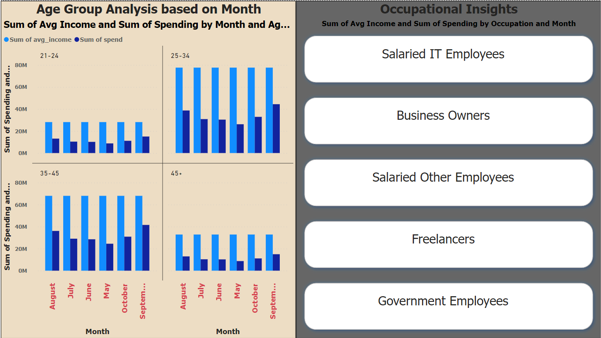
Key Data Points: Age, Month, Occupation for Enhanced Clarity
Diving into the dataset, we scrutinize variables such as age group, month, and occupation.
This initial exploration aims for a clearer understanding, laying the foundation for insightful data analysis.
By dissecting these key factors, we pave the way for strategic insights that align with specific demographic and temporal trends.

Slide 6
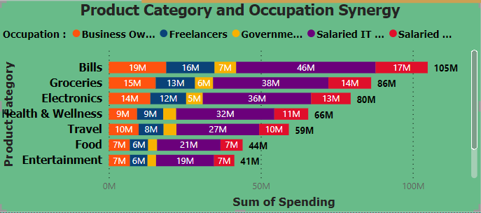
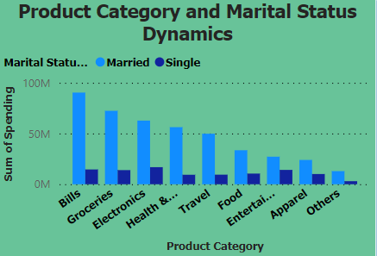
Consumer Dynamics: Unraveling Links in Product, Occupation, and Marital Status
Analyzing the synergy between product category and occupation reveals strategic connections in consumer choices.
This insight enables Mitron Bank to tailor financial products that resonate with specific occupational preferences, enhancing market relevance
Examining product category and marital status dynamics, we unveil correlations shaping consumer behaviors.
This exploration delves into the interplay between purchasing preferences and marital status, offering valuable insights for targeted marketing strategies.
Understanding these dynamics enriches our data analysis, fostering a nuanced approach to tailor Mitron Bank's product offerings.

Slide 7
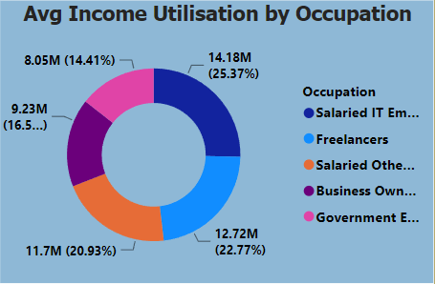
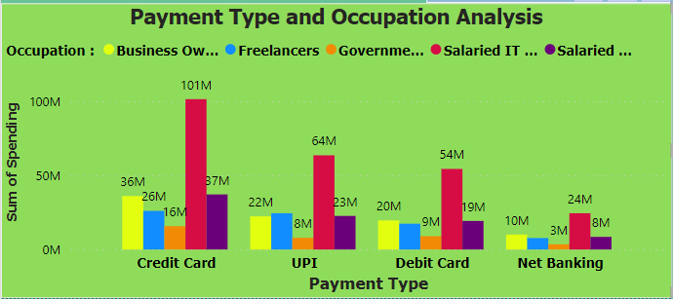
Occupation Insights: Navigating Avg Income Utilization and Payment Preferences
Examining payment types in conjunction with occupations unveils intricate financial behaviors.
This analysis provides a nuanced understanding for Mitron Bank to tailor services, aligning with diverse payment preferences across different professional domains.
Exploring the nexus of average income utilization and occupation sheds light on spending patterns within specific professional realms.
This analysis holds the key to aligning Mitron Bank's financial solutions with the distinct needs and utilization behaviors across various occupations.

Slide 8
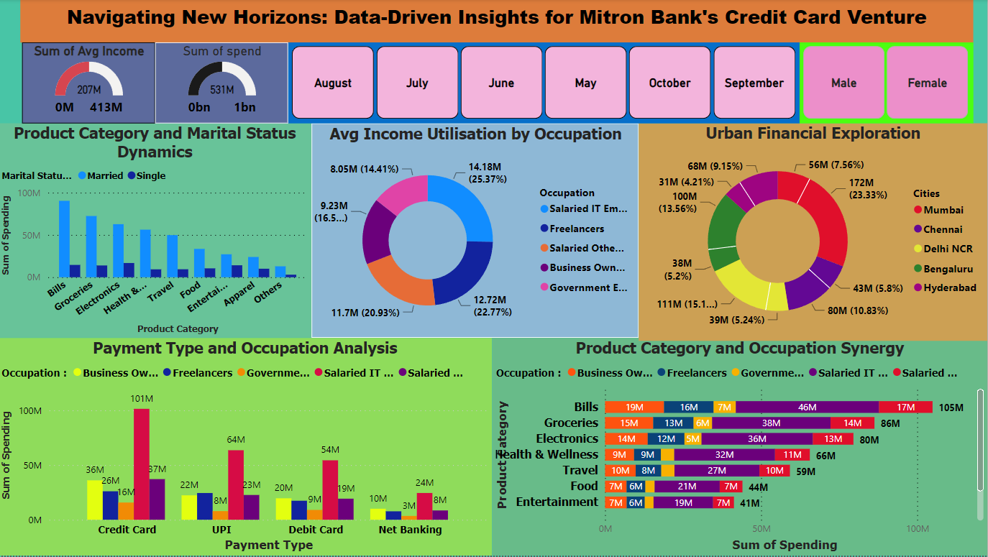
COMPREHENSIVE ANALYSIS AND INSIGHTS DASHBOARD

Slide 9
Conclusion and Strategic Focus for Mitron Bank
The comprehensive analysis suggests several strategic focus areas for Mitron Bank's business development.
Occupational Segmentation:
Given the notable spending and income utilization patterns, a targeted approach towards IT professionals, salaried individuals, and freelancers can yield substantial business development opportunities.
Gender-Based Tailoring:
Acknowledging the nuanced spending dynamics between genders, Mitron Bank should consider crafting gender-specific credit card features and benefits, ensuring a more personalized offering.

Slide 10
Metropolitan Focus:
Cities such as Mumbai, Bengaluru, and Delhi stand out as high-potential areas. Mitron Bank should prioritize targeted marketing and service optimization strategies in these metropolitan centers.
Monthly Variations:
A closer examination of monthly spending dynamics provides a blueprint for aligning promotions, rewards, and marketing efforts with specific months, enhancing customer engagement and satisfaction.
Product Category Refinement:
Understanding the product categories driving significant spending allows Mitron Bank to refine credit card features and rewards, ensuring alignment with customer preferences and market trends.
By strategically focusing on these key areas, Mitron Bank can drive better business development, enhance customer satisfaction, and position itself as a leading player in the dynamic financial services landscape.

